Slide 1
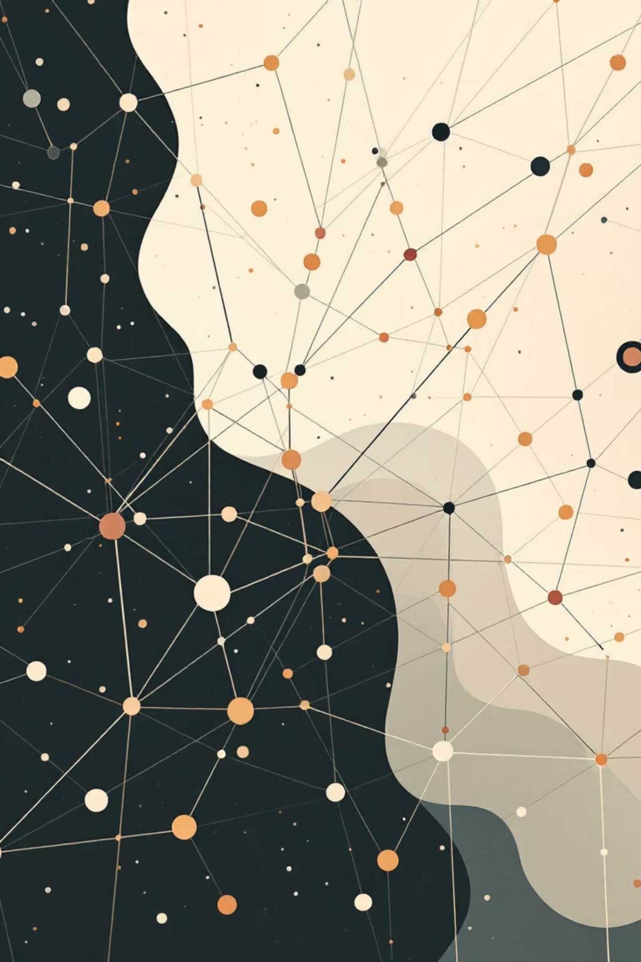
What is Machine Learning?
Teaching computers to learn from data and make decisions without being explicitly programmed for every single task.
Dr. Zainab Malik | zainabmalik@um.edu.my

Slide 2
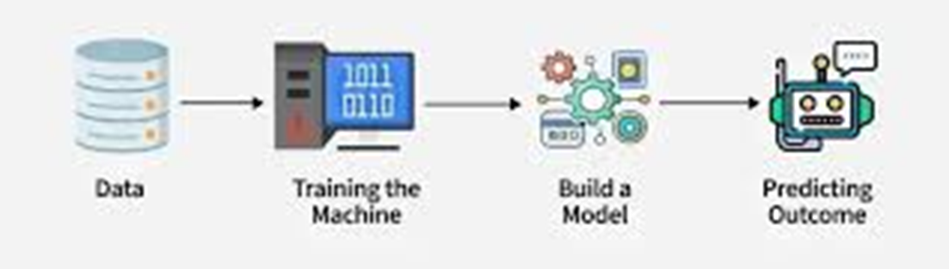
Machine Learning
Machine Learning is the science of teaching computers to learn from examples, without being explicitly programmed for every single task.

Slide 3

Why is ML Everywhere?
Machine learning powers the digital experiences you use every day, often without you even realizing it.
Personalized Recommendations
Voice Assistants
Face Recognition
Netflix, Spotify, and YouTube suggest content tailored to your preferences.
Siri and Alexa understand and respond to natural language commands.
Your phone unlocks instantly by recognizing your unique facial features.
Why Now?
Massive amounts of data available
Powerful and affordable computing
Continuously improving algorithms

Slide 4
The Three Main Types of Machine Learning
Understanding these foundational approaches will help you grasp how different ML systems work.
Supervised Learning
Unsupervised Learning
Reinforcement Learning
Learn from labeled examples
Predict an output from input data. Like studying with an answer key.
Find hidden patterns
Learn by trial and error
Discover structure in unlabeled data without predefined categories.
Learn optimal actions through rewards and penalties over time.
Example: Predict house prices based on size and location.
Example: Computer mastering video games through practice.
Example: Group customers by shopping behavior patterns.

Slide 5
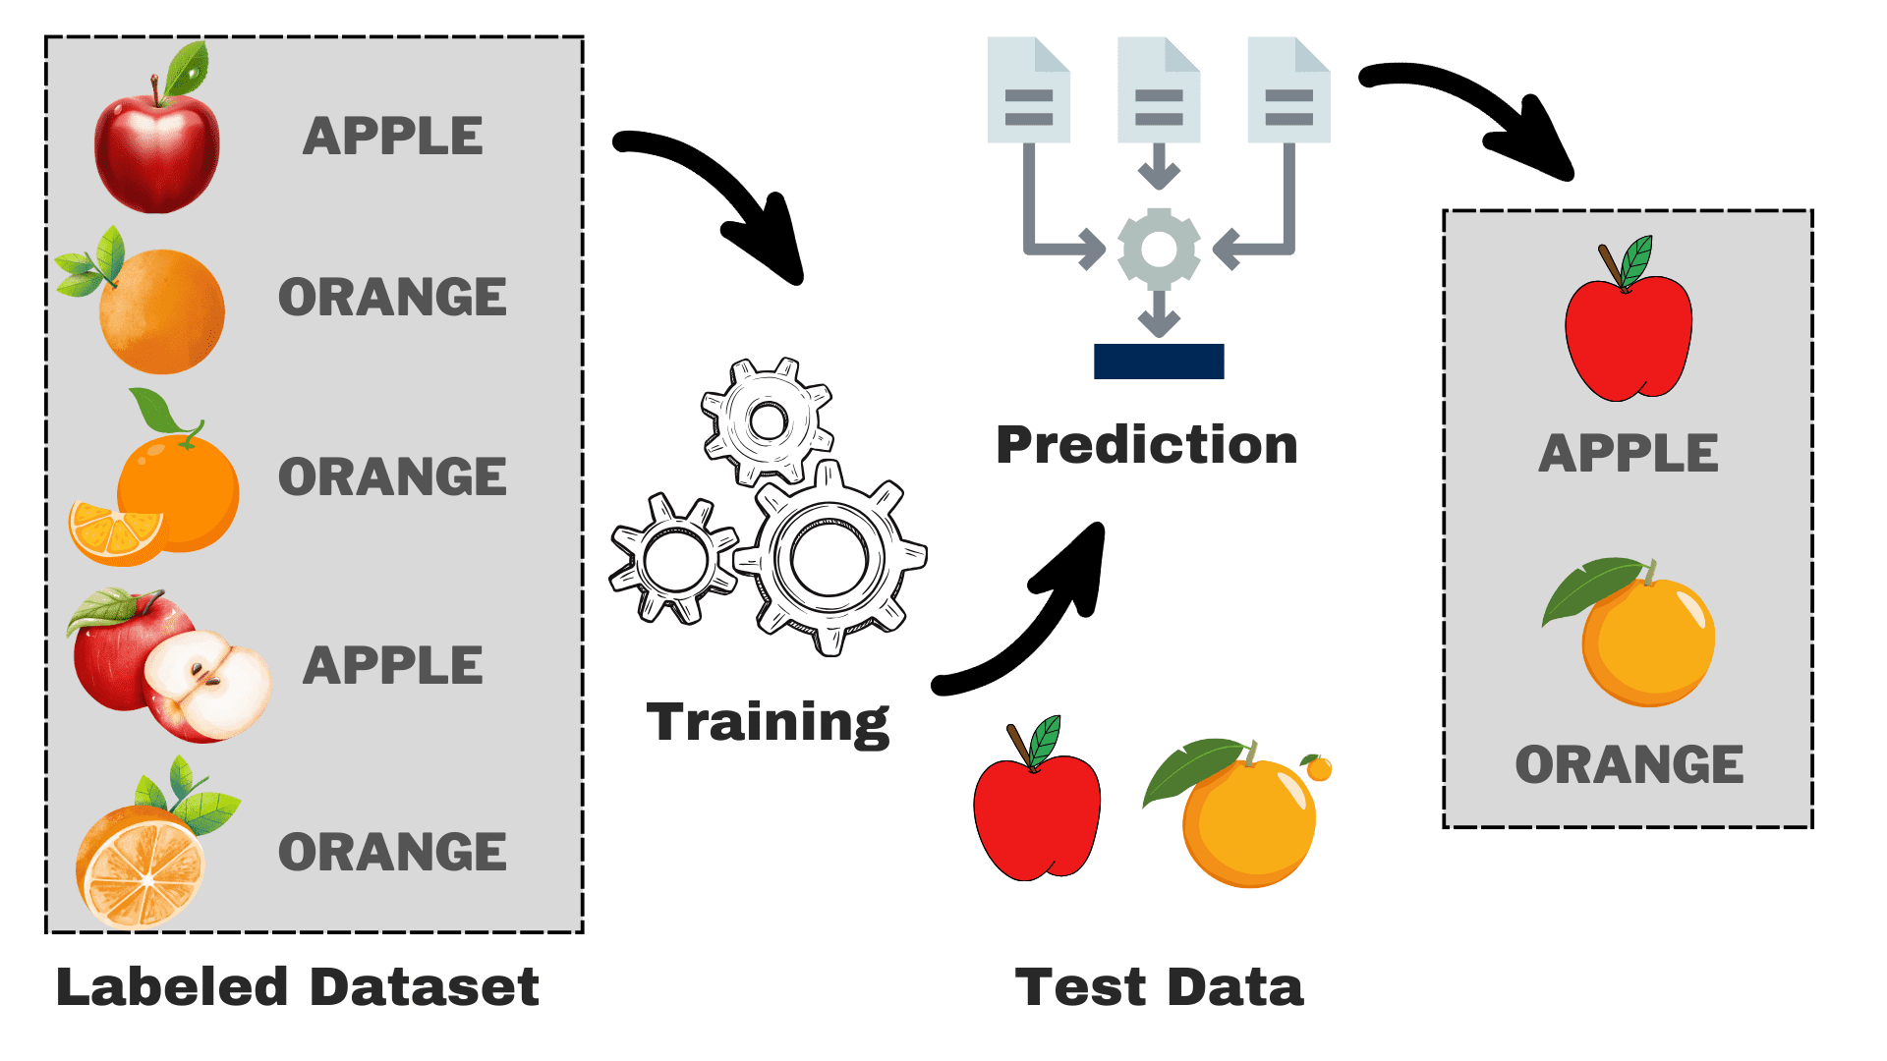

Slide 6
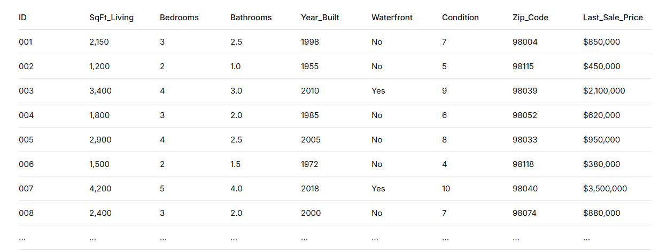

Slide 7
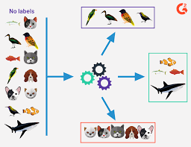

Slide 8
E-commerce Company Challenge:
"We have 50,000 customers, but don't understand who they are.
How can we group similar customers to personalize marketing?“
Business Goals:
Targeted email campaigns
Product recommendations
Loyalty programs
Inventory planning
Customer retention strategies
ML Task: Group customers by behavior without predefined categories

Slide 9
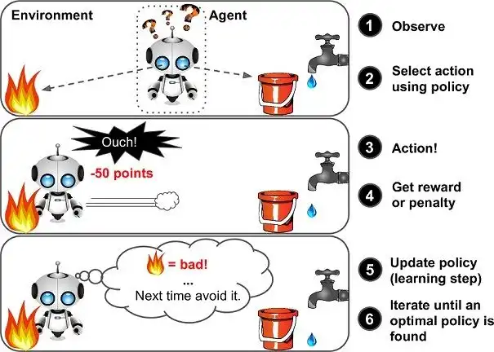

Slide 10




Supervised Learning in Detail
Supervised learning is the most common type of ML, where the algorithm learns from labeled training data to make predictions on new, unseen data.
Two Main Tasks
The Process
Regression
Train with Labeled Data
Predict a continuous number
Provide historical examples with known answers
What will the temperature be tomorrow?
How much will this stock be worth?
Model Learns Patterns
What's the expected delivery time?
Algorithm identifies relationships in the data
Classification
Predict New Data
Predict a category or label
Apply learned patterns to make predictions
Is this email spam or not spam?
Does this image contain a cat or dog?
Will this customer churn?

Slide 11
A Simple ML Workflow
Every machine learning project follows a similar pipeline, from raw data to deployed predictions.
01
02
Collect Data
Clean & Prepare Data
Gather relevant data from various sources and systems.
Handle missing values, remove errors, and format consistently. This is the most time-consuming step!
03
04
Choose a Model
Train the Model
Select the appropriate algorithm for your specific
problem type.
Let the algorithm learn patterns from your prepared training data.
05
06
Evaluate Performance
Deploy & Use
Test how well the model performs on new, unseen data.
Put the model into production to make real-world predictions.

Slide 12


Understanding the "Model"
What is a model?
A model is the "program" or "function" that the ML algorithm creates from your data. It's a mathematical representation of the patterns discovered during training.
Simple Example - A Linear Model:
Predicted Price = (a × Size) + b
The ML algorithm finds the best numbers for a and b by analyzing your data.
Think of it as a recipe the computer writes for itself based on examples you've shown it. Once trained, this recipe can be applied to new situations to make predictions.

Slide 13

Key points
Keep these fundamental principles in mind as you continue your machine learning
journey.
Garbage In, Garbage Out
The quality of your data is absolutely crucial. Poor data leads to poor predictions, no matter how sophisticated your algorithm.
It's Not Magic
ML is built on math, statistics, and careful experimentation. Understanding the
fundamentals helps you use it effectively.
Start Simple
A simple model you understand is always better than a complex "black box" you don't.
Build complexity gradually.
Ethics Matters
Models can reflect and amplify human biases present in training data. We must build AI systems responsibly and thoughtfully.

Slide 14
Thank You

